Slide 1
Practice 3
yao zhao

Slide 2
Question 1
Lanran has tasks to do, while the tasks are not independent. That means to do some task Lanran needs to finish other task first. Now given the dependency of the tasks, Lanran wants you to tell him one possible order to finish all these tasks. To make the output answer unique, the answer should have the least lexicographical order among all possible answers. If there is no possible answer, please output 'impossible' (without quotes).

Slide 3
Sample input：
Graph：
5 4
1 4
1 3
4 3
1 5
4
1
3
2
5
Sample output：
1 2 4 3 5

Slide 4
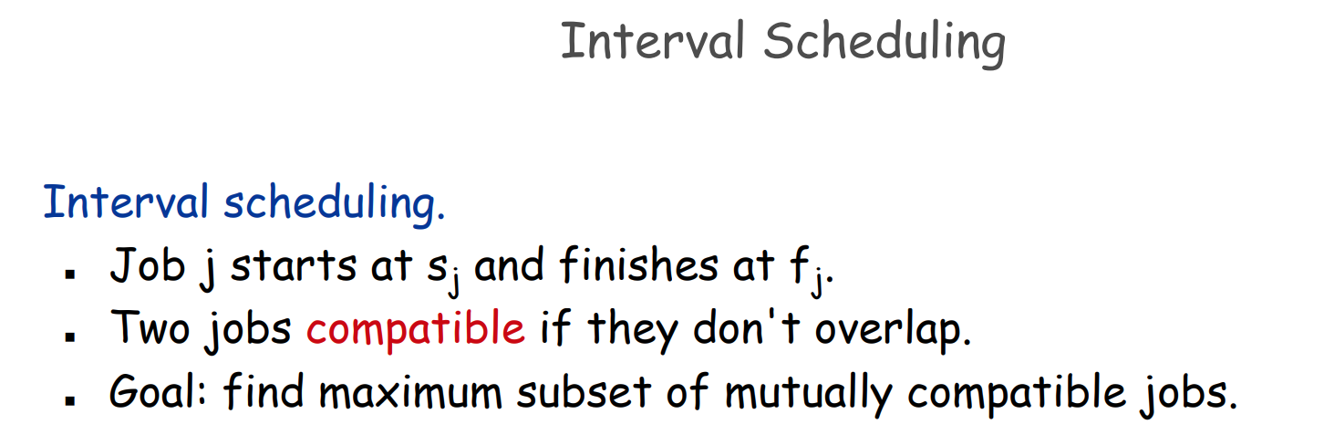
Question 2

Slide 5
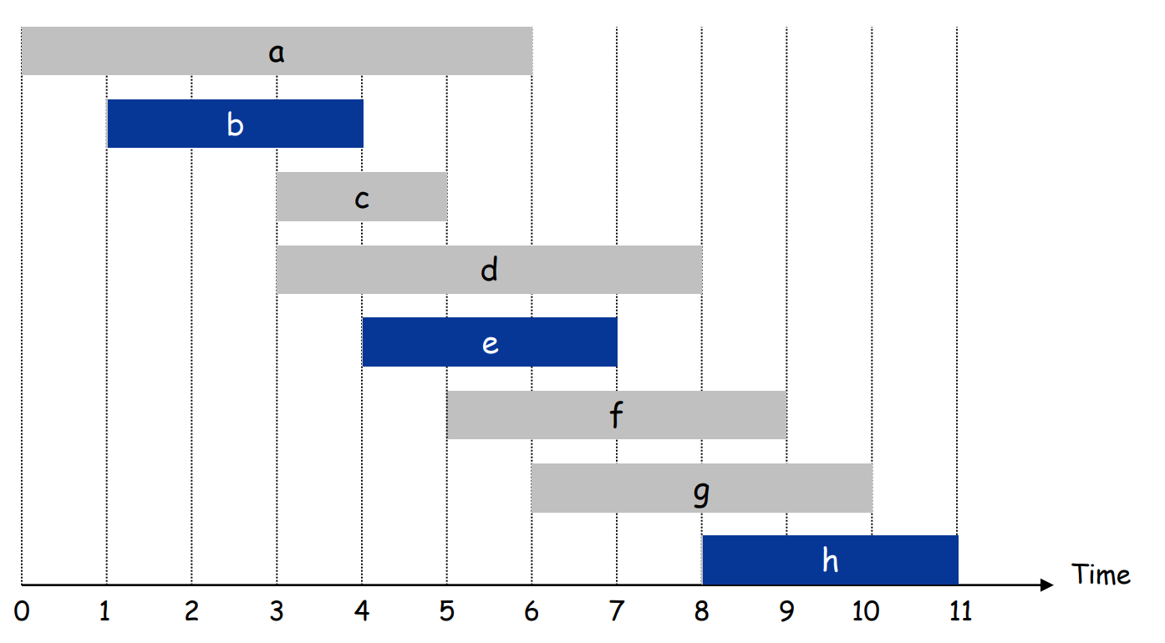
Sample input：
a 0 6
b 1 4
c 3 5
d 3 8
e 4 7
f 5 9
g 6 10
h 8 11
Sample output：
b e h

Slide 6
Please implement the 2 questions.
The practice will be checked in this lab class or the next lab class(before Apr.6) by teachers or SAs.
This practice will contribute 1 mark to your overall grade. Late submissions within 2 weeks after the deadline (before Apr.20)will incur a 20% penalty, meaning that you can only get 80% of the score.

